Slide 2
About Softvent….. We are into Product Development and Customised Software Solution providers since 1999. Softvent offers its customers a focused and responsive approach to solutions delivery. We strive to leverage on cutting edge technologies and project management tools, using them to our advantage in the execution of all our projects keeping the highest levels of quality in mind. Softvent, which was started by small team, is now a world class Application Solutions
Provider with a state of the art development center in Bengaluru, India. "Technology which keeps you ahead" has always been our motto. Our goal is to provide comprehensive business solutions to help achieve your business objectives completely. We have seen tremendous growth in the last Two Decades. As an organization we have grown from a two-employee company to over 30 employees. In the process we have seen a compounded annual growth of over 100% each year.

Slide 3
Salient Features
Our off-site storage solution for your hard-copy files and electronic documents gives you flexible access to your documents.
We can send you details on storage, a history of activity and a comprehensive spend and trend analysis. This granular reporting is built for you, to give you transparency over where your records are, when they’ve been retrieved and when they’re scheduled for disposal.
Whether it’s hard-copy legacy documents, which pose greater challenges for digitization, or digital documents.
Through managing the creation, capture, indexing, storage, retrieval and secure destruction of information.

Slide 4
Salient Features – Continued…
Efficient document search and retrieval
Secure and instant information sharing
Intuitive user interface
Notifications & Reminders
Cloud Backup Too
Your documents are stored in a local system and are perfectly safe, yet if you wish, you can easily upload the whole data or individual files/images to your cloud too, as often as you like for your local backup. MyDocTracker Sync is a Windows desktop application that allows easy data syncing! Can be possible based on case to case.
Add Context
Add/create multiple Groups or custom fields, set reminders, alarm, multiple attachments.

Slide 5
Salient Features – Continued…
The main advantages of MyDocTracker are:
Increased productivity
Reduced operational time.
Improved quality.
High degree of accuracy.
Data Accessing and Searching made simple.
Document/Image attachment.
Security and access control.
Classification, Search and retrieval.
Integration with cloud application.
Reports: Create and use your own SQL Reports. Reports are generated in Excel/PDF format.
Many more…

Slide 6
HOME PAGE

Slide 7
LOGIN SCREEN
Enter the User code and Password to get logged in.

Slide 8
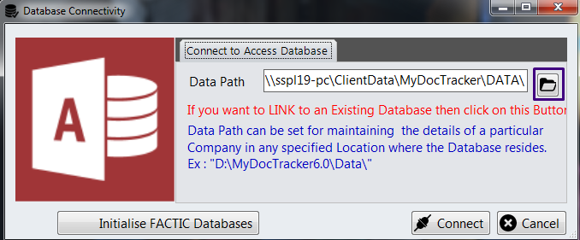
DATABASE CONNECTIVITY
Here we need to set the Database path by browsing the folder.

Slide 9
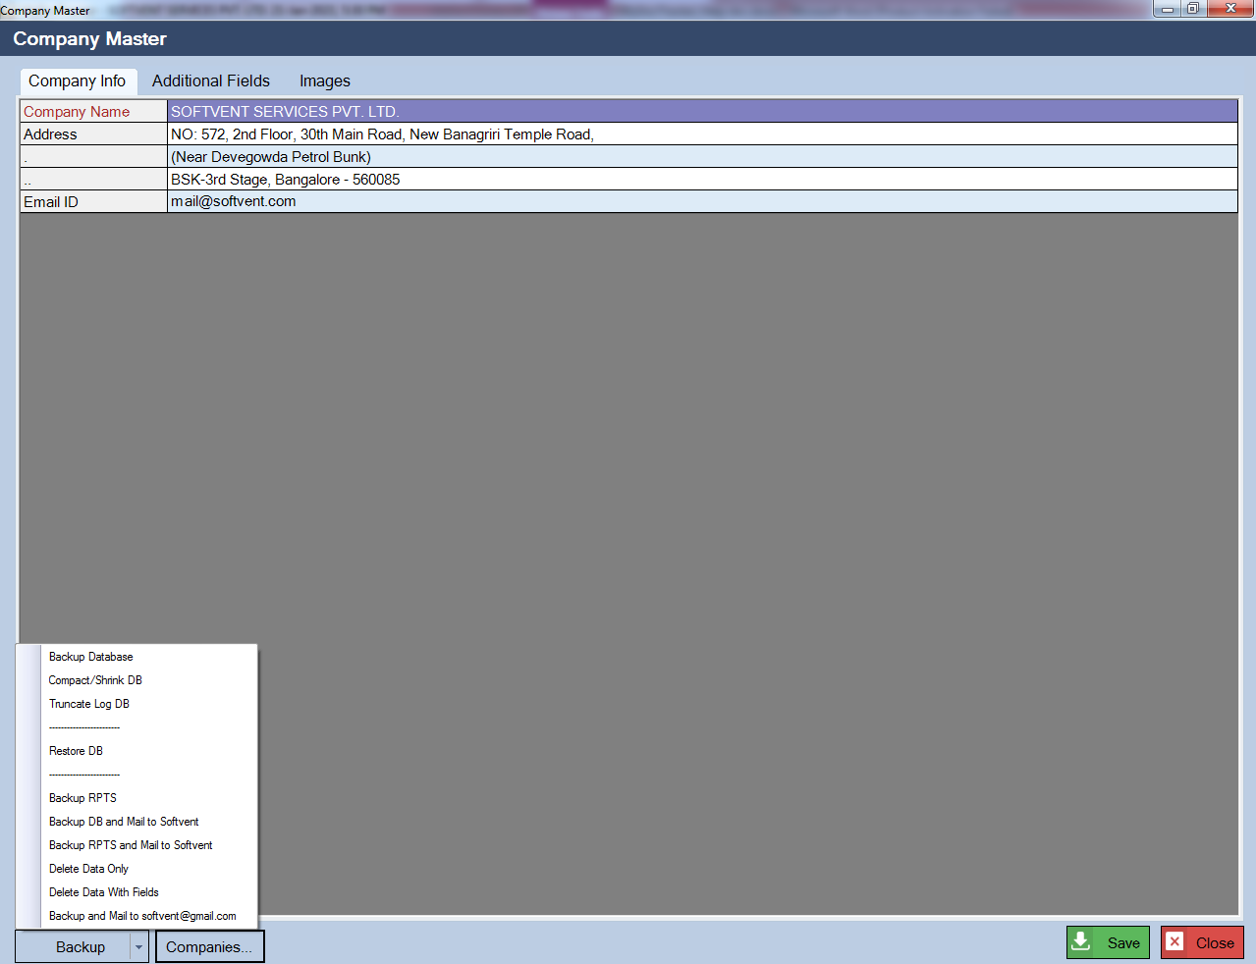
COMPANY SETTINGS
Here we can enter the company Details.
In order to take Database Backup and perform other action, we can select the respective option as shown in the Image.

Slide 10
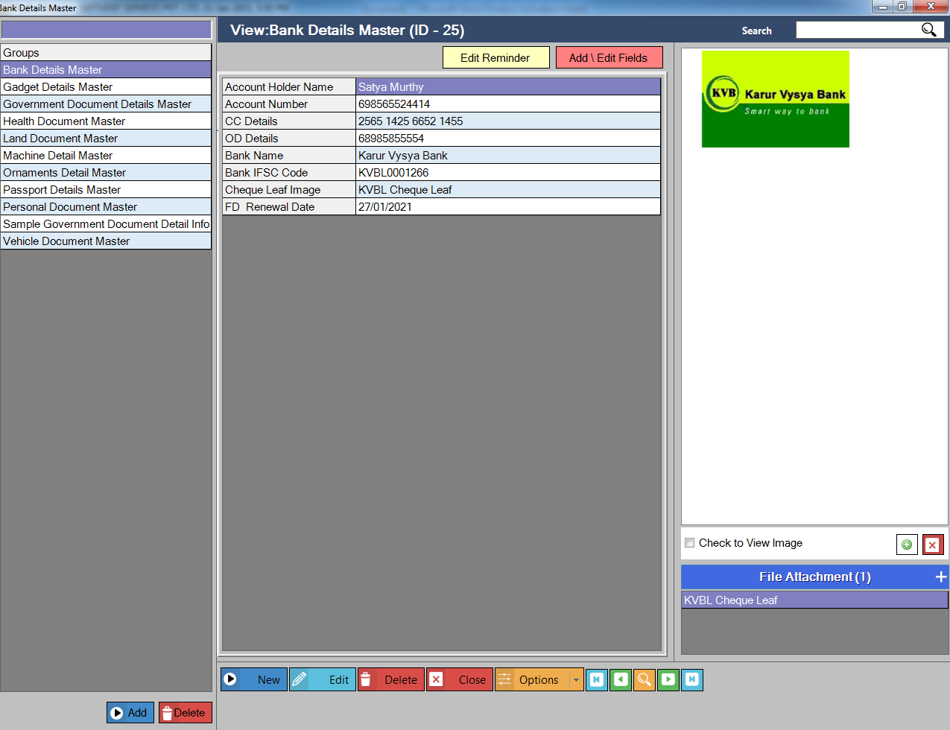
Info
Here we can Add multiple Group Masters in order to store the records. Example: Bank Details Master.

Slide 11
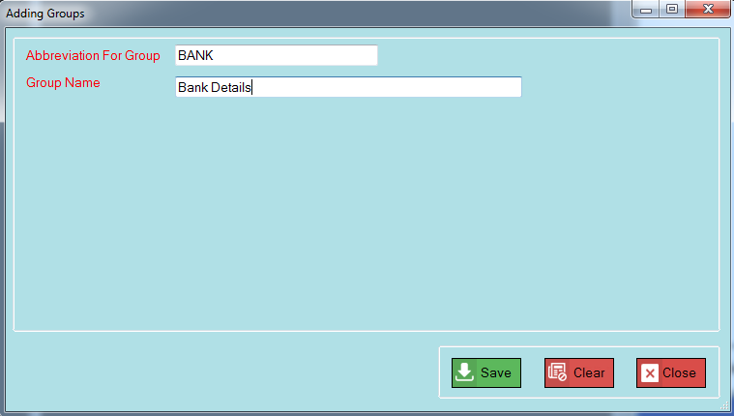
Info
Steps to Add New Group:
1. Click on Add Button
2. Enter Abbreviation for Group and Group Name
3. Click On Save

Slide 12
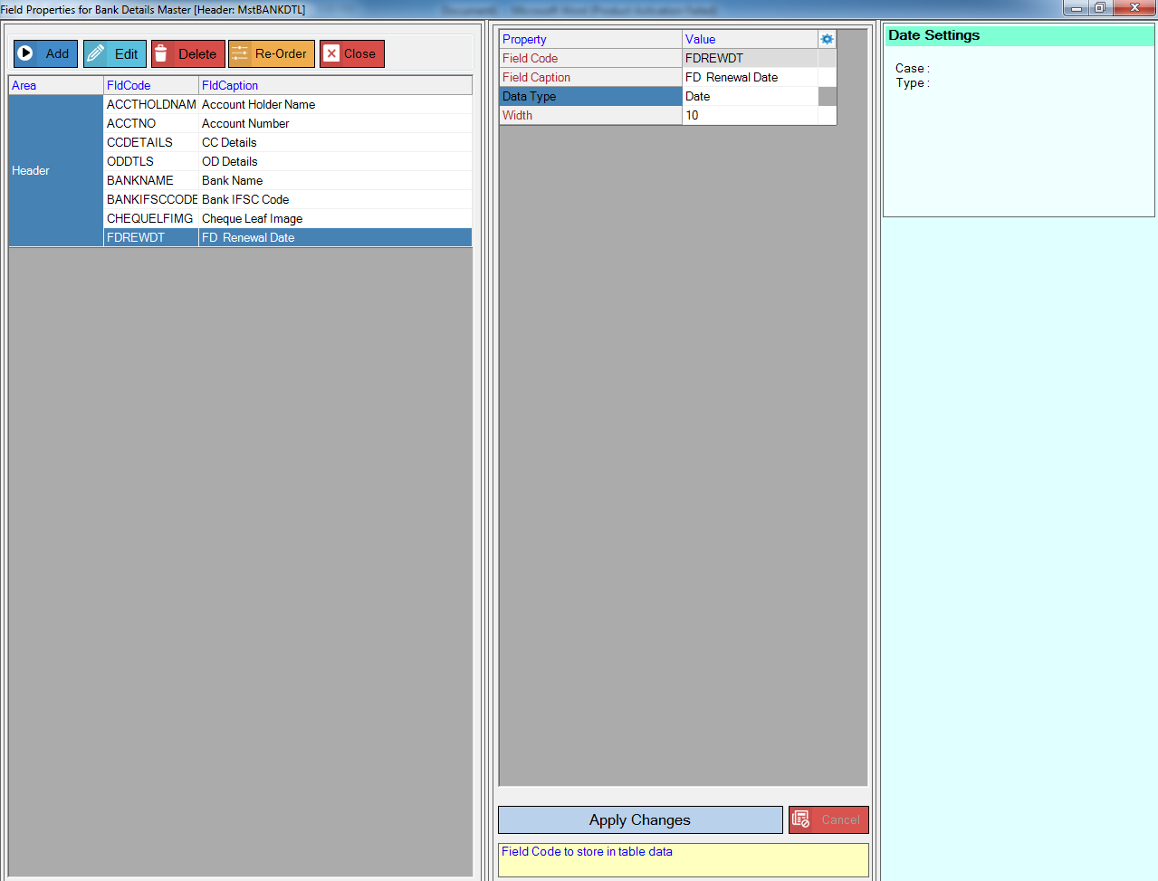
Info
4. Then Click on Add\Edit Fields to add the fields of the group.
Here we can Add, Edit, Delete and Reorder Fields.
For Example: In Bank Detail Master – We can add all the fields as shown in the image.

Slide 13
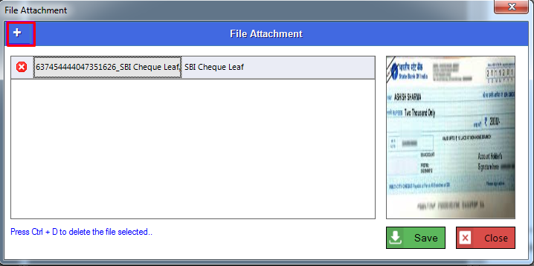
Info
5. Then for file attachment, click on edit button.
Then as shown in the below image, click on + symbol to add the attachments.

Slide 14
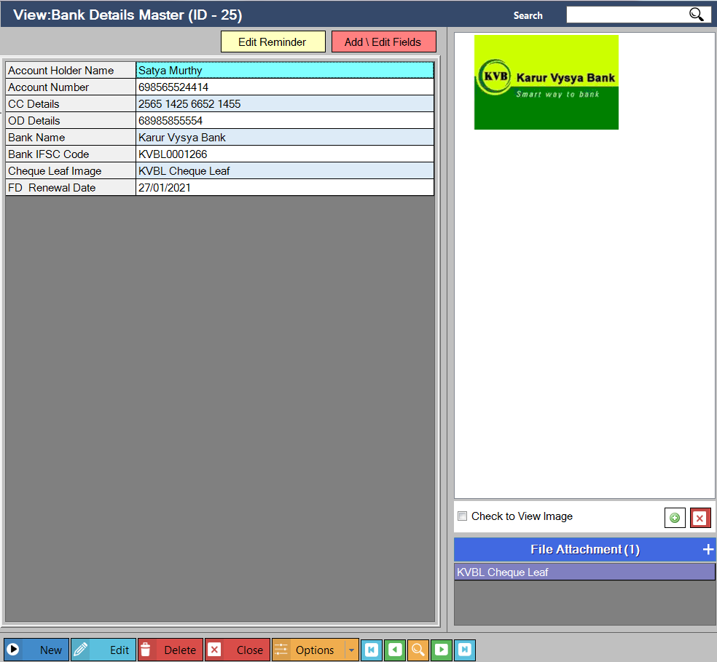
Info
We can also add the image at right side of the screen as shown below.

Slide 15
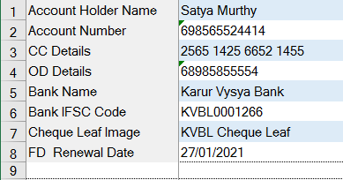
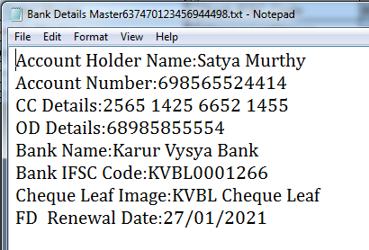
Info
And also we export each record in Excel and Notepad.

Slide 16
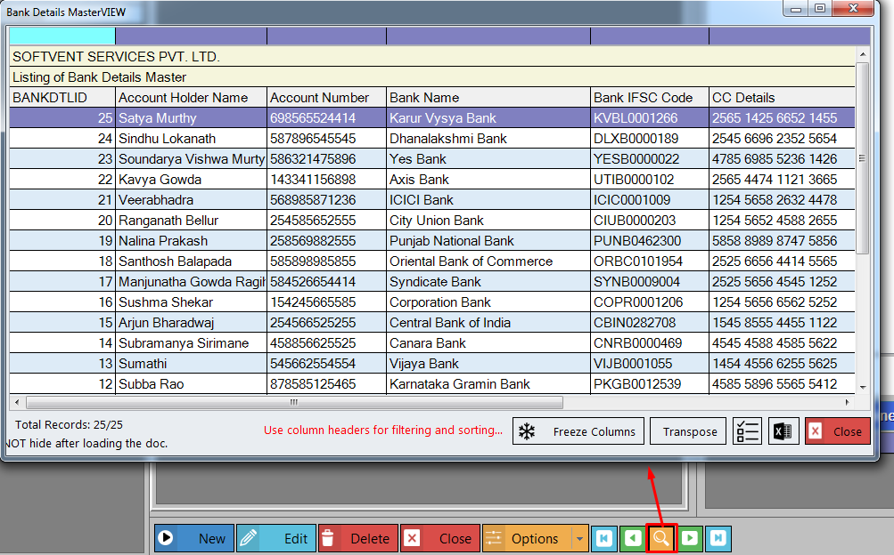
Info
We can view all the records in (search)

Slide 17
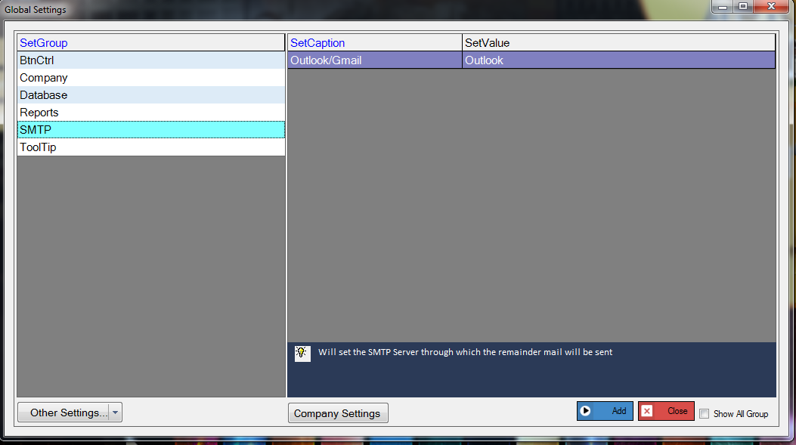
Info
Set Reminder:
This is used to edit the Reminder Message.
It will send email / SMS for the date which is been set.
Example: We can set reminder for the FD Renewal Date as shown below.
Here, From the Start date, the Reminder message will be sent daily till the reminder of that record gets deleted.
To set whether we want to send the mail through Gmail or Outlook, We need to set the SMTP value in Global settings first.

Slide 18
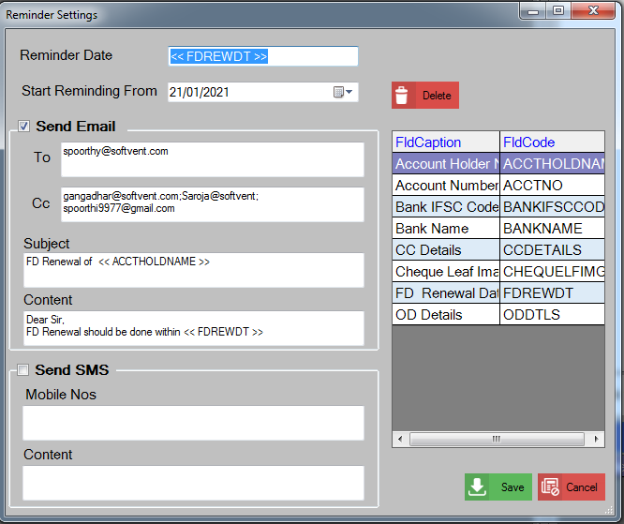
Info
Set Reminder:
After Setting the Reminder, we need to run the MyDocNotify.exe

Slide 19
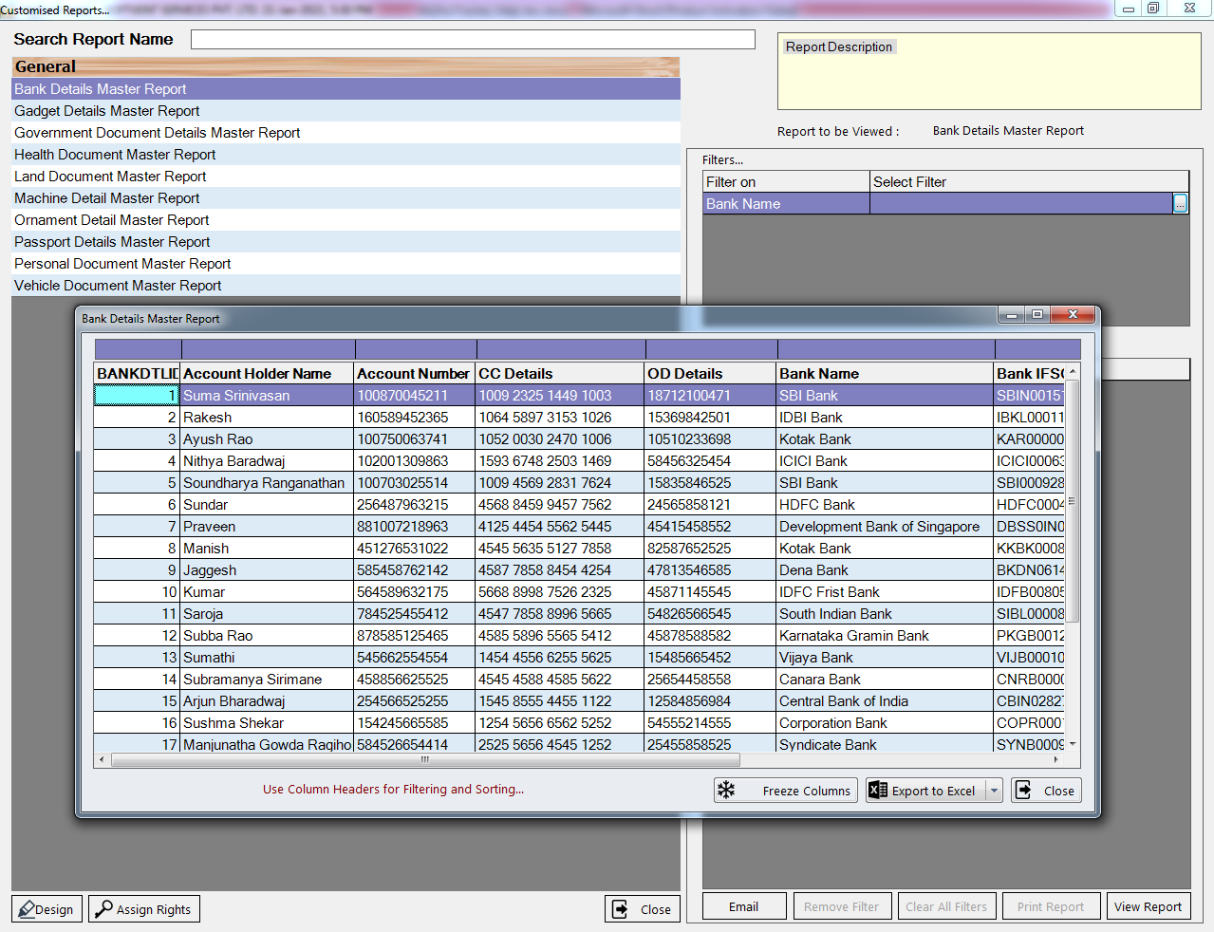
Reports
A Custom Report is a report that you decide how they should be displayed.
These are user defined reports. This can be changed according to the user requirement.

Slide 20
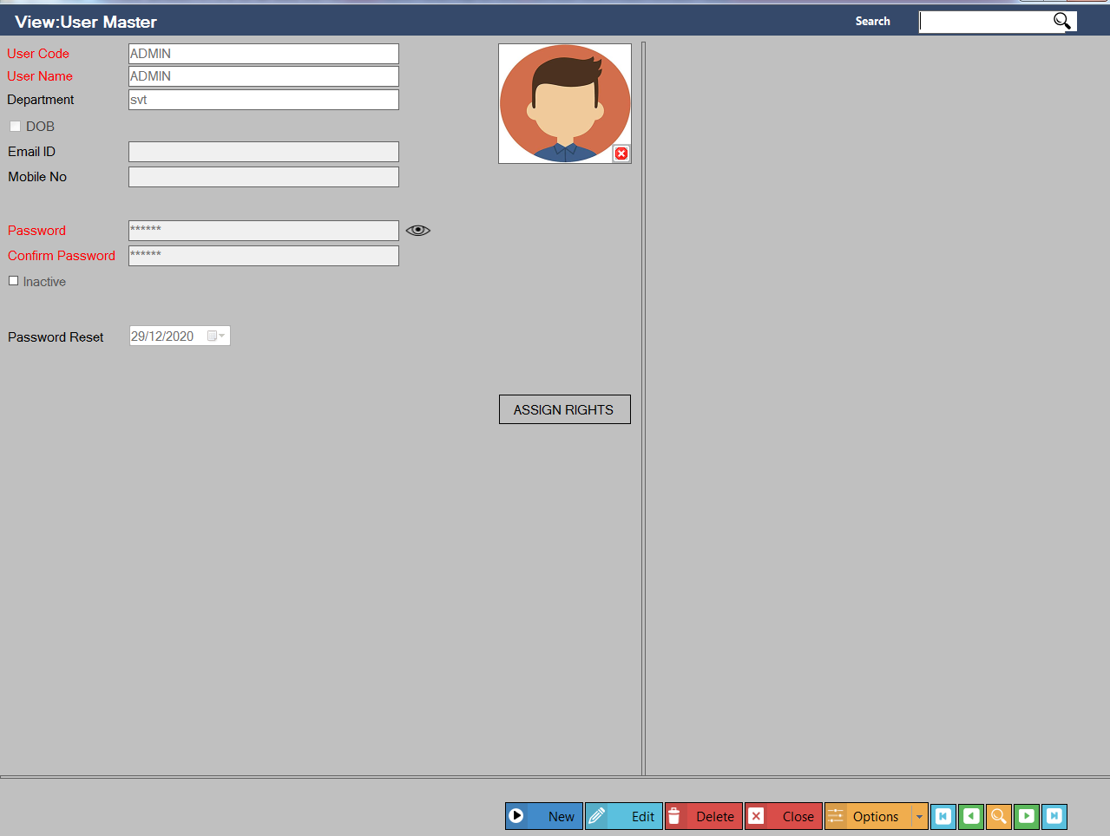
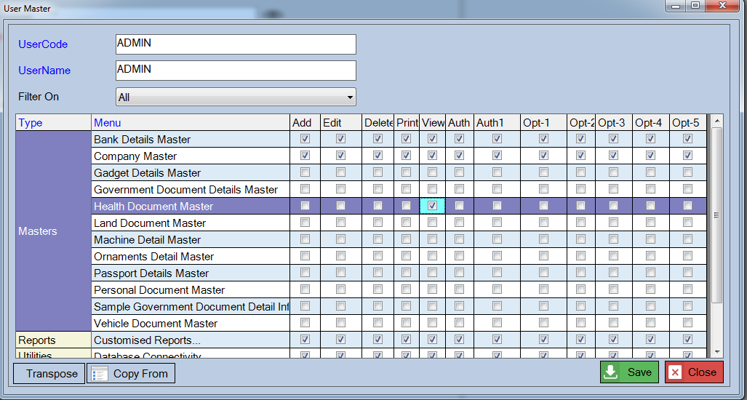
SECURITY
Security allows creating new username and password. This screen allows the user to access required form by disabling other forms as shown below.

Slide 21
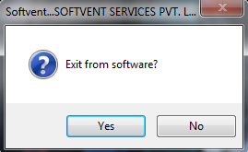
EXIT
This is used to exit the Software.

Slide 22
Thank You
Need to understand how a MyDocTracker could potentially help you, or simply get a software at your affordable price. contact one of our experts today.
Softvent Services Pvt Ltd
more info @ softvent.com
Support / Sales Contact on
9900918613
9945036934
9880606365

